Slide 1
OPENSHIFT CONTAINER PLATFORM
TECHNICAL OVERVIEW
PRESENTER NAME
PRESENTER TITLE
DATE

Slide 2
Functional overview

Slide 3
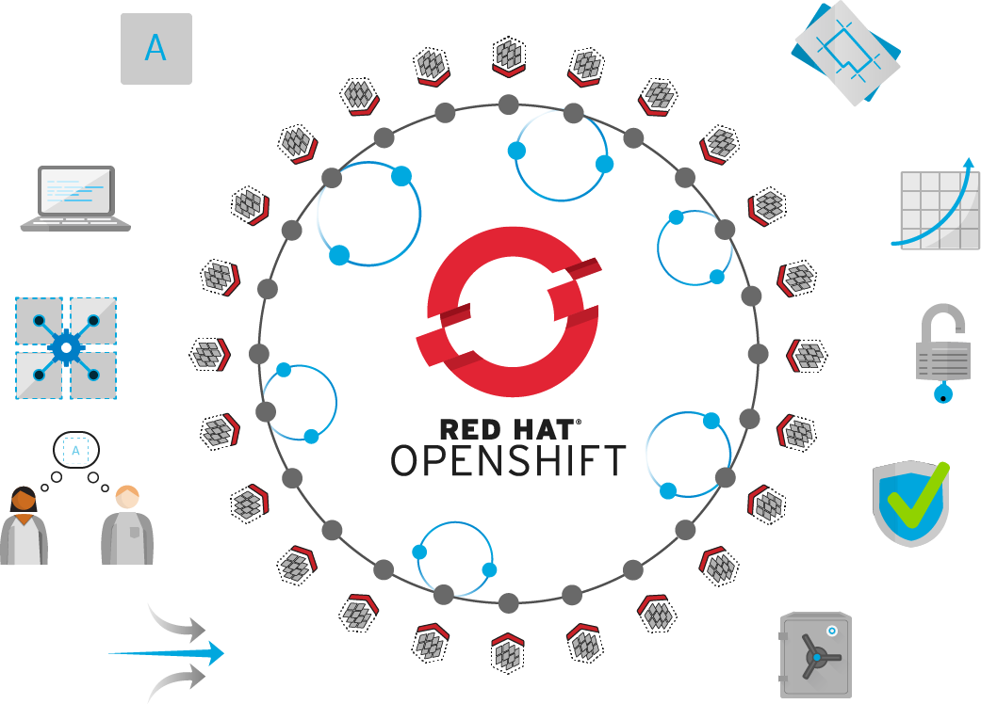
OPENSHIFT CONTAINER PLATFORM | Technical Value
Self-Service
Standards-based
Multi-language
Web-scale
Automation
Open Source
Collaboration
Enterprise Grade
Multi-tenant
Secure

Slide 4
OPENSHIFT CONTAINER PLATFORM | Functional Overview
Value of OpenShift
Monitoring, Logging, Registry, Router, Telemetry
Service Mesh, Serverless, Middleware/Runtimes, ISVs
Dev Tools, CI/CD, Automated Builds, IDE
Cluster Services
Application Services
Developer Services
Automated Operations
Kubernetes
Red Hat Enterprise Linux | RHEL CoreOS
Best IT Ops Experience
CaaS
PaaS
FaaS
Best Developer Experience

Slide 5


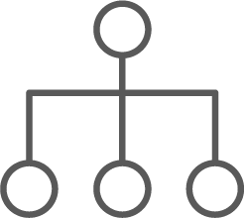




OPENSHIFT CONTAINER PLATFORM | Architectural Overview
MASTER
WORKER
WORKER
Red Hat® OpenShift®
services
Kibana | Elasticsearch
Kibana | Elasticsearch
SCM
(GIT)
Infrastructure
services
Registry
Registry
Kubernetes
services
Router
Router
Developers
CI/CD
Prometheus | Grafana Alertmanager
Prometheus | Grafana Alertmanager
etcd
EXISTING AUTOMATION TOOLSETS
Monitoring | Logging | Tuned SDN | DNS | Kubelet
Monitoring | Logging | Tuned SDN | DNS | Kubelet
Admins
COMPUTE
NETWORK
STORAGE

Slide 6
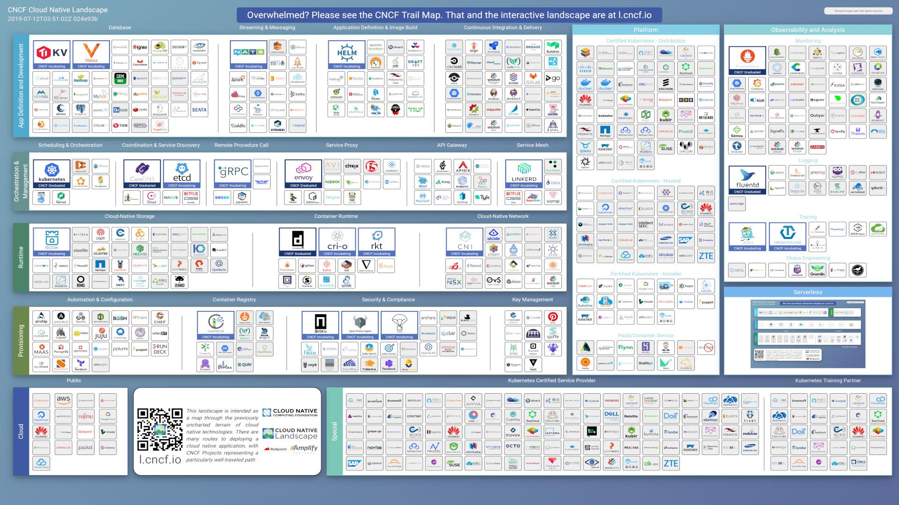
CNCF Ecosystem Slide

Slide 7
OpenShift and Kubernetes core concepts

Slide 8
OpenShift Concepts
a container is the smallest compute unit
CONTAINER

Slide 9
OpenShift Concepts
containers are created from container images
IMAGE
CONTAINER
BINARY
RUNTIME

Slide 10
OpenShift Concepts
container images are stored in an image registry
IMAGE REGISTRY
IMAGE
IMAGE
IMAGE
CONTAINER
IMAGE
IMAGE
IMAGE

Slide 11
OpenShift Concepts
an image repository contains all versions of an image in the image registry
IMAGE REGISTRY
myregistry/frontend
myregistry/mongo
frontend:latest
frontend:2.0
frontend:1.1
frontend:1.0
mongo:latest
mongo:3.7
mongo:3.6
mongo:3.4
IMAGE
IMAGE
IMAGE
IMAGE
IMAGE
IMAGE
IMAGE
IMAGE

Slide 12
OpenShift Concepts
containers are wrapped in pods which are units of deployment and management
POD
POD
CONTAINER
CONTAINER
CONTAINER
10.140.4.44
10.15.6.55

Slide 13
OpenShift Concepts
ReplicationControllers & ReplicaSets ensure a specified number of pods are running at any given time
1
2
N
image name
replicas
labels cpu memory
storage
POD
POD
POD
...
CONTAINER
CONTAINER
CONTAINER
ReplicaSet ReplicationController

Slide 14
OpenShift Concepts
a daemonset ensures that all (or some) nodes run a copy of a pod
✓
✓
image name
replicas
labels cpu memory
storage
POD
POD
CONTAINER
CONTAINER
DaemonSet
Node
Node
Node
foo = bar
foo = bar
foo = baz

Slide 15
OpenShift Concepts
configmaps allow you to decouple configuration artifacts from image content
Dev
Prod
appconfig.conf
MYCONFIG=true
POD
appconfig.conf MYCONFIG=false
POD
CONTAINER
CONTAINER
ConfigMap
ConfigMap

Slide 16
OpenShift Concepts
secrets provide a mechanism to hold sensitive information such as passwords
Dev
Prod
hash.pw
ZGV2Cg==
POD
hash.pw cHJvZAo=
POD
CONTAINER
CONTAINER
ConfigMap
ConfigMap
Notes:
Secure mechanism for holding sensitive data e.g.
Passwords and credentials
SSH Keys
Certificates
Secrets are made available as
Environment variables
Volume mounts
Interaction with external systems
Encrypted in transit and at rest
Having an easy-to-use, secure-by-default secret distribution mechanism is exactly what developers and ops need to solve the secrets management problem once and for all
Because secret objects can be created independently of the pods that use them, there is less risk of the secret being exposed during the workflow of creating, viewing, and editing pods.
A secret is only sent to a node if a pod on that node requires it. It is not written to disk. It is stored in a temporary file-storage facilities (tmpfs). It is deleted once the pod that depends on it is deleted.
Secrets are stored as plaintext in etcd however the etcd storage can be encrypted to remove the security risk

Slide 17
OPENSHIFT & KUBERNETES CONCEPTS
services provide internal load-balancing and service discovery across pods
SERVICE
“backend”
role: backend
POD
POD
POD
POD
role: frontend
CONTAINER
role: backend
CONTAINER
role: backend
CONTAINER
role: backend
CONTAINER
10.140.4.44
10.110.1.11
10.120.2.22
10.130.3.33

Slide 18
OPENSHIFT & KUBERNETES CONCEPTS
apps can talk to each other via services
SERVICE
“backend”
role: backend
POD
POD
POD
POD
role: frontend
CONTAINER
role: backend
CONTAINER
role: backend
CONTAINER
role: backend
CONTAINER
10.140.4.44
10.110.1.11
10.120.2.22
10.130.3.33

Slide 19
OpenShift Concepts
routes make services accessible to clients outside the environment via real-world urls
app-prod.mycompany.com
ROUTE
SERVICE
“frontend”
> curl http://app-prod.mycompany.com
role: frontend
POD
POD
POD
role: frontend
CONTAINER
role: frontend
CONTAINER
role: frontend
CONTAINER
Notes:
A route exposes a service at a host name, like www.example.com, so that external clients can reach it by name.
DNS resolution for a host name is handled separately from routing. Admin may have configured a DNS wildcard entry that will resolve to the node that is running the OpenShift Container Platform router
Pods running on OpenShift, don’t need to go through the routing layer and can interact with each other directly through the services.
After the router discovers the Pod endpoints via the service, it sends the Pod traffic directly to those endpoints and bypasses the service layer

Slide 20

OpenShift Concepts
projects isolate apps across environments, teams, groups and departments
PAYMENT DEV
CATALOG
POD
POD
POD
❌
POD
POD
POD
C
C
C
C
C
C
PAYMENT PROD
INVENTORY
POD
POD
POD
❌
❌
POD
POD
POD
C
C
C
C
C
C

Slide 21
OpenShift lifecycle, installation & upgrades

Slide 22
OpenShift 3.11 Installation
Two new paradigms for deploying clusters

Slide 23

Host Preparation

Slide 24
Pre Requisits
Infrastructure
IP Address Segment
DNS Server
Subscriptions
Internet Access
x86 Hardware
Master Nodes
16 GB RAM
QUAD Core CPU
2 Disks / min 50 GB
Nodes
8 GB RAM
Dual Core CPU
2 Disks / min 50 GB

Slide 25


Prep. Installation all Node(s)
Install OPENSHIFT on RHEL 7.3 / 7.4
Subscribe to the required cannels
—enable=„rhel-7-server-rpms" \
—enable=„rhel-7-server-extras-rpms" \
—enable=„rhel-7-server-ose-3.9-rpms" \
—enable=„rhel-7-fast-datapath-rpms" \
--enable="rhel-7-server-ansible-2.4-rpms"
Install Bases Packages
yum install wget git net-tools bind-utils iptables-services
bridge-utils bash-completion kexec-tools sos psacct
If you want to use the RPM Installer
yum install atomic-openshift-utils
Install the following package, which provides RPM-based OpenShift Container Platform installer utilities and pulls in other tools required by the quick and advanced installation methods, such asAnsible and related configuration files:
yum install atomic-openshift-utils

Slide 26
Prep. Installation all Node(s) 2/3
Install and Configure Docker
Install Docker
yum install docker-1.13.1
Configure insecure registiry
Edit the /etc/sysconfig/docker file and add --insecure-registry 172.30.0.0/16
Configure Docker Storage
cat <<EOF > /etc/sysconfig/docker-storage-setup
DEVS=/dev/vdc
VG=docker-vg
EOF
run docker-storage-setup
Start Docker
systemctl enable docker
systemctl start docker

Slide 27
Prep.Installation on one Node only (Install Node)
Ensuring Host Access
The quick and advanced installation methods require a user that has access to all hosts. If you want to run the installer as a non-root user, passwordless sudo rights must be configured on each destination host.
-> ssh-keygen ->Do not use a password.
An easy way to distribute your SSH keys is by using a bash loop:
for host in master.example.com \
node1.example.com \
node2.example.com; \
do ssh-copy-id -i ~/.ssh/id_rsa.pub $host; \
done

Slide 28




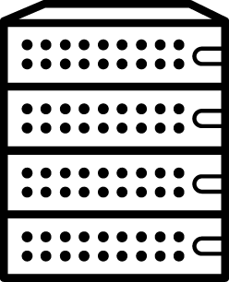


NOTHING ROUTINE SHOULD BE DONE MANUALLY
System Admin
add Playbook
Security Validation
Create
Security Baseline
Maintenance
push the button
Provision
Security Manager
App Delivery Team
Configure
Patch
report
deploy
Virtual
Machine
Server
OS Image
Configured Server
Approved Server
App-Ready Server
Pool of Running Servers

Slide 29







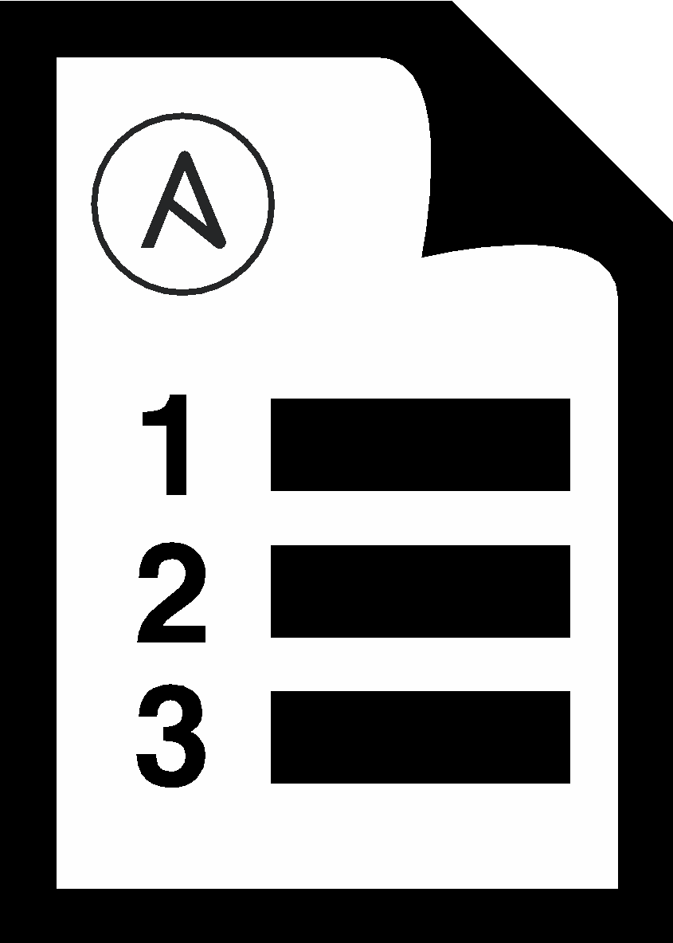



HOW ANSIBLE WORKS
CMDB
PUBLIC / PRIVATE CLOUD
PUBLIC / PRIVATE CLOUD
ANSIBLE’S AUTOMATION ENGINE
USERS
HOSTS
INVENTORY
API
APPS & SERVICES
MODULES
PLUGINS
ANSIBLE PLAYBOOK
NETWORK DEVICES

Slide 30
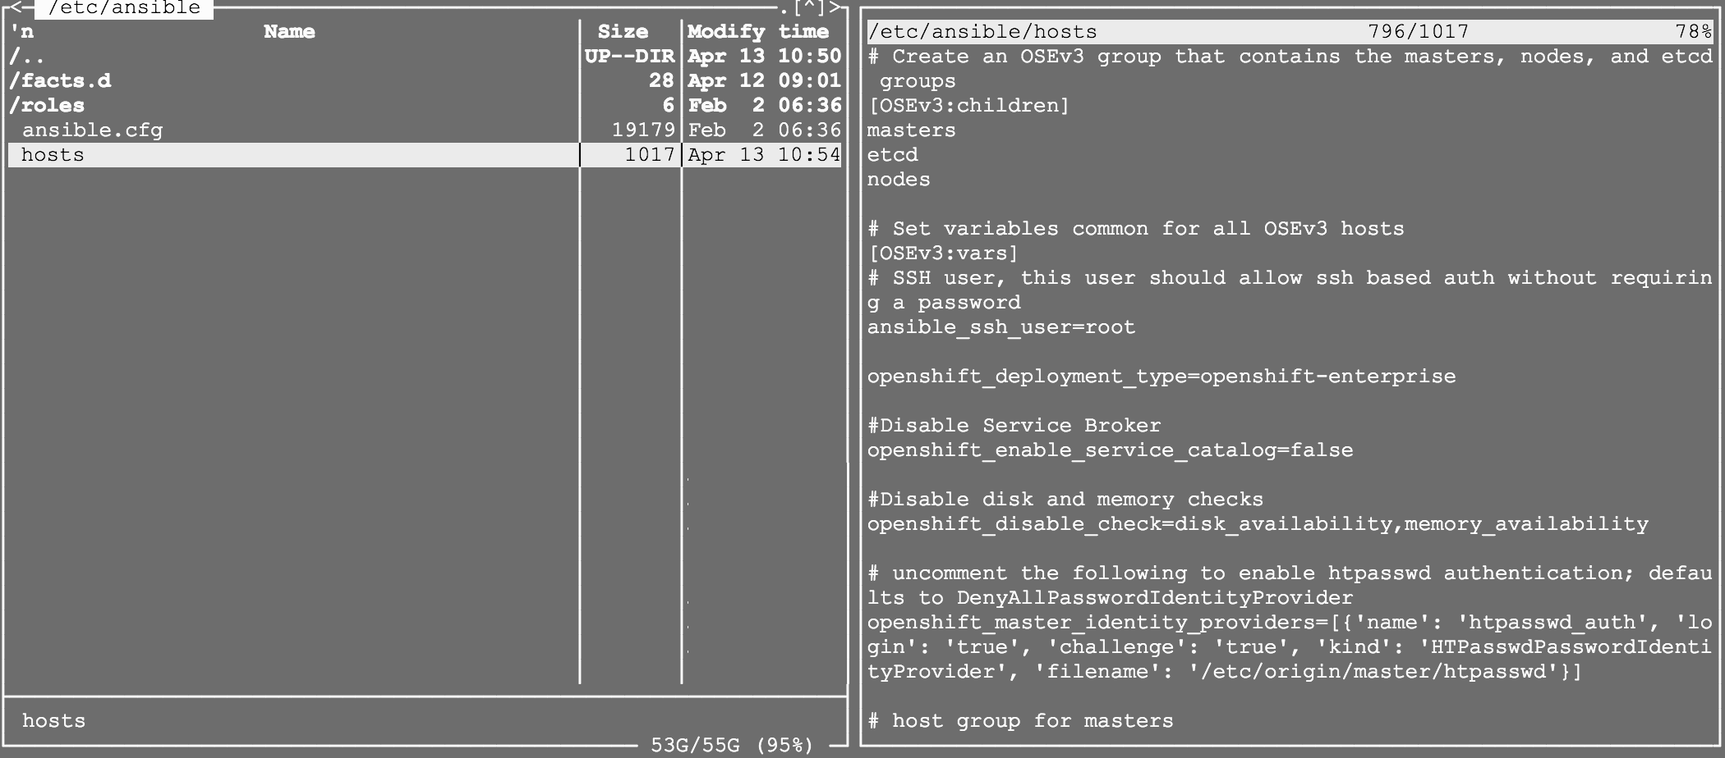
/etc/ansible/hosts

Slide 31
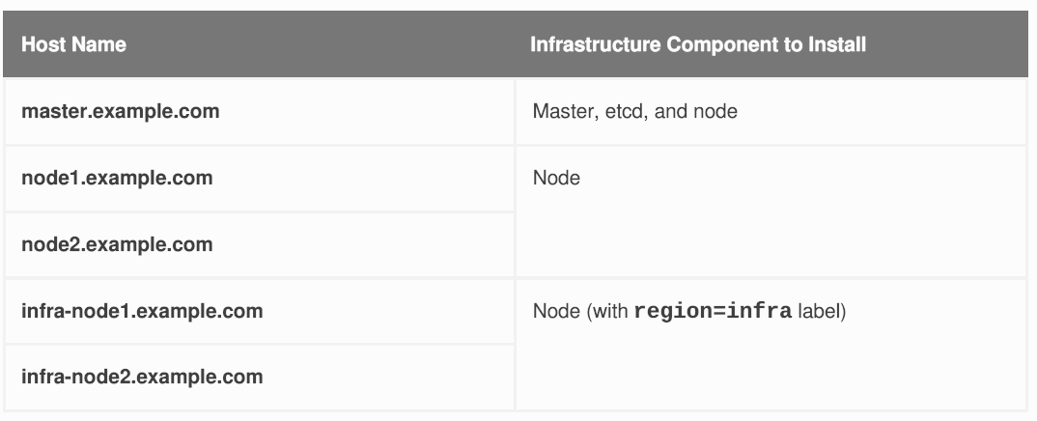
Example Inventory Files (Single Master)

Slide 32
Example Inventory Files (Single Master)
# Create an OSEv3 group that contains the masters, nodes, and etcd groups
[OSEv3:children]
masters
nodes
etcd
# Set variables common for all OSEv3 hosts
CHAPTER 2. INSTALLING A CLUSTER
85
[OSEv3:vars]
# SSH user, this user should allow ssh based auth without requiring a
password
ansible_ssh_user=root
# If ansible_ssh_user is not root, ansible_become must be set to true
#ansible_become=true
openshift_deployment_type=openshift-enterprise
# uncomment the following to enable htpasswd authentication; defaults to
DenyAllPasswordIdentityProvider
#openshift_master_identity_providers=[{'name': 'htpasswd_auth', 'login':
'true', 'challenge': 'true', 'kind': 'HTPasswdPasswordIdentityProvider',
'filename': '/etc/origin/master/htpasswd'}]

Slide 33
Example Inventory Files (Single Master) (cont)
# host group for masters
[masters]
master.example.com
# host group for etcd
[etcd]
master.example.com
# host group for nodes, includes region info
[nodes]
node1.example.com openshift_node_labels="{'region': 'primary', 'zone':
'east'}"
node2.example.com openshift_node_labels="{'region': 'primary', 'zone':
'west'}"
infra-node1.example.com openshift_node_labels="{'region': 'infra', 'zone':
'default'}"
infra-node2.example.com openshift_node_labels="{'region': 'infra', 'zone':
'default'}"

Slide 34
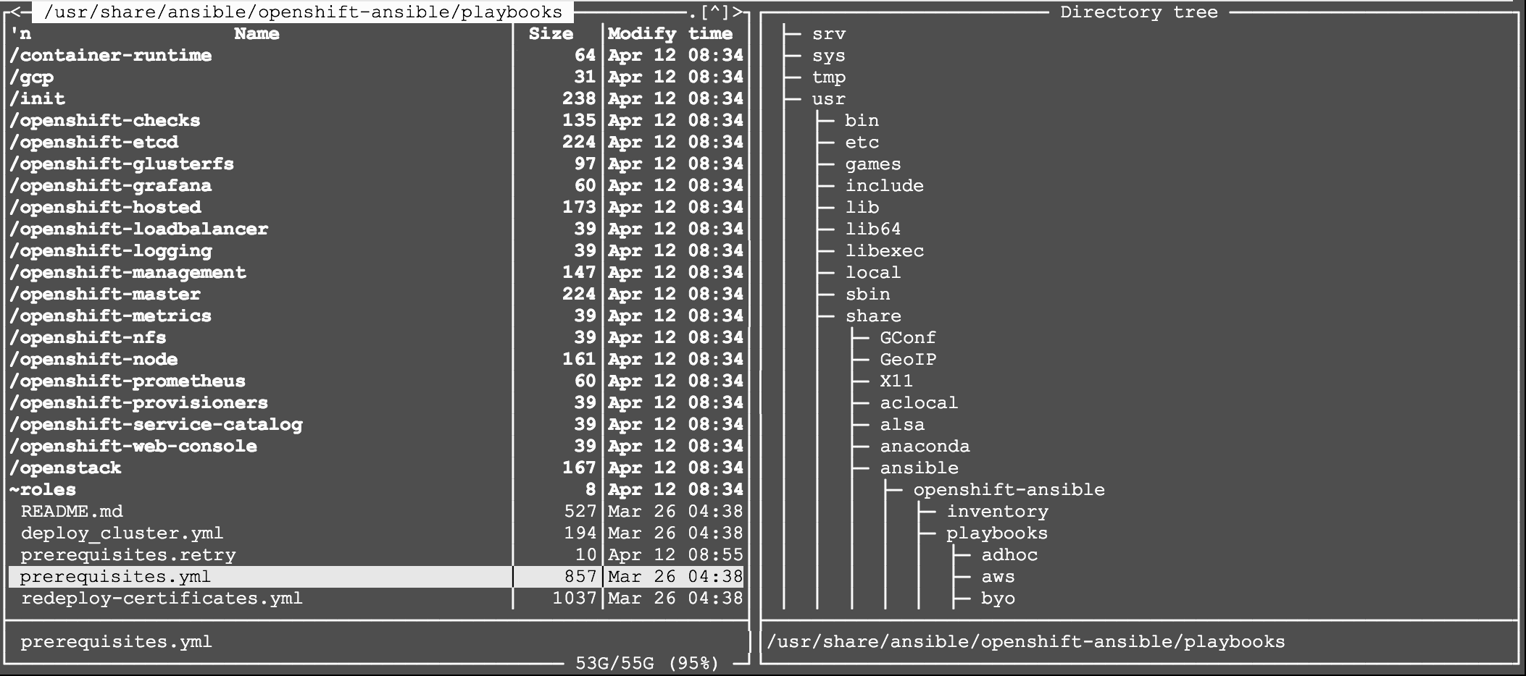
Ansible Playbook(s)

Slide 35
Host & Playbook
Preflight check:
ansible-playbook /usr/share/ansible/openshift-ansible/playbooks/prerequisites.yml
Install:
Ansible-playbook /usr/share/ansible/openshiftansible/playbooks/deploy_cluster.yml

Slide 36
You end up with ...
Single Master
& ETCD
InfraNode
InfraNode
Worker Node
(west)
Workernode
(east)

Slide 37
H/A for Master ?

Slide 38
Example Inventory Files (Single Master) Add HA for Master Node
# host group for masters
[masters]
Master.example.com
master2.example.com
master3.example.com
# host group for etcd
[etcd]
Master.example.com
master2.example.com
master3.example.com
# host group for nodes, includes region info
[nodes]
node1.example.com openshift_node_labels="{'region': 'primary', 'zone':'east'}"
node2.example.com openshift_node_labels="{'region': 'primary', 'zone':'west'}"
infra-node1.example.com openshift_node_labels="{'region': 'infra', 'zone':'default'}"
infra-node2.example.com openshift_node_labels="{'region': 'infra', 'zone':'default'}"

Slide 39
ScaleUp
Ansible-playbook /usr/share/ansible/openshiftansible/playbooks/openshift_master/scaleup.yml

Slide 40
You end up with ...
Master & ETCD
Master
& ETCD
Master
& ETCD
InfraNode
InfraNode
Worker Node
East
Worker Node
West

Slide 41
Need more nodes ?

Slide 42
Example Inventory Files (Single Master) Add HA for Master Node
# host group for masters
[masters]
master.example.com
master2.example.com
master3.example.com
# host group for etcd
[etcd]
aster.example.com
master2.example.com
master3.example.com
# host group for nodes, includes region info
[nodes]
node1.example.com openshift_node_labels="{'region': 'primary', 'zone':'east'}"
node2.example.com openshift_node_labels="{'region': 'primary', 'zone':'west'}"
node3.example.com openshift_node_labels="{'region': 'primary', 'zone':'north'}"
node4.example.com openshift_node_labels="{'region': 'primary', 'zone':'south'}"
infra-node1.example.com openshift_node_labels="{'region': 'infra', 'zone':'default'}"
infra-node2.example.com openshift_node_labels="{'region': 'infra', 'zone':'default'}"

Slide 43
ScaleUp
Ansible-playbook /usr/share/ansible/openshiftansible/playbooks/openshift_node/scaleup.yml

Slide 44
You end up with ...
Master & ETCD
Worker Node
north
Worker node
south
Master
& ETCD
Master
& ETCD
InfraNode
InfraNode
Worker Node
west
Worker node
east

Slide 45
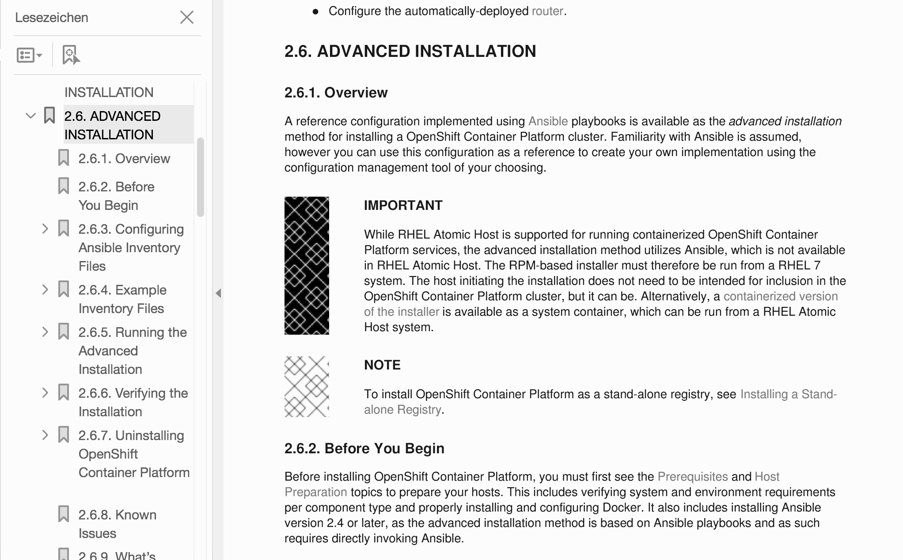
More Features (Options) ?

Slide 46
OpenShift 4 Installation
Two new paradigms for deploying clusters

Slide 47


Installation Paradigms
OPENSHIFT CONTAINER PLATFORM | Installation
OPENSHIFT CONTAINER PLATFORM
HOSTED OPENSHIFT
Full Stack Automated
Simplified opinionated “Best Practices” for cluster provisioning
Fully automated installation and updates including host container OS.
Pre-existing Infrastructure
Customer managed resources & infrastructure provisioning
Plug into existing DNS and security boundaries
Azure Red Hat OpenShift
Deploy directly from the Azure console. Jointly managed by Red Hat and Microsoft Azure engineers.
OpenShift Dedicated
Get a powerful cluster, fully
Managed by Red Hat engineers and support.

Slide 48
Full-stack Automated Installation
OPENSHIFT CONTAINER PLATFORM | Installation
User managed
Operator managed
Control Plane
Worker Nodes
OCP Cluster Resources
OCP Cluster
openshift-install deployed
RH CoreOS
RH CoreOS
RH CoreOS
RH CoreOS
RHEL CoreOS
RHEL CoreOS
Cloud Resources
Cloud Resources
Notes:
What’s Full Stack Automated Deployments?
All portions of the underlying infrastructure including networking (subnets, DNS entries, & load balancers), machines, and operating systems are programmatically created during installation rather than by the administrator. The installer handles creating and destroying all the infrastructure objects it needs to in order to be successful. This installation method allows for full stack automation with automated updates of both OpenShift and RHEL CoreOS delivered together. While this installation method is highly reliable and provides a best practices deployment of OpenShift, it’s not designed to provide a high degree of infrastructure customization for environments that have may have complex operational requirements.
Finally, it’s worth mentioning that for OpenShift 4 upgrades are no longer the responsibility of the installer and instead handled entirely through the new operator framework, which will be explained later.

Slide 49
Pre-existing Infrastructure Installation
OPENSHIFT CONTAINER PLATFORM | Installation
User managed
Operator managed
Control Plane
Worker Nodes
OCP Cluster Resources
openshift-install deployed
OCP Cluster
Note: Control plane nodes must run RHEL CoreOS!
RH CoreOS
RH CoreOS
RHEL 7
RHEL CoreOS
RHEL CoreOS
Customer deployed
Cloud Resources
Cloud Resources
Notes:
What’s Pre-existing Infrastructure Deployments?
The administrator must create their own infrastructure, which includes creating networks, configuring DNS, setting up load balancers, provisioning machines, and installing operating systems. Meaning the administrator, not the installer, is ultimately responsible for the creation and deletion of these infrastructure objects. Even though the administrator is tasked with this work, it allows more customization of the infrastructure based on operational requirements whereas infrastructure customization for full stack automated deployments only delivers an opinionated best practices install with far less options for customizing.
Once the user managed infrastructure has been provisioned, OpenShift 4 can then be deployed. Even though the installer won’t be leveraged to provision the infrastructure, the same installer is still used to generate the node assets and monitor the bring-up of the cluster.
In terms of a running cluster, there’s really no discernible operational difference between the two installation methods. Neither is inferior to the other and over the air updates can still be performed. The only real tangible benefit with a pre-existing infrastructure deployments is the added support for RHEL 7 worker and infra nodes (in addition RHEL CoreOS node support). However, RHEL 7 host OS updates still need to be managed independently by the administrator unlike RHEL CoreOS which gets delivered alongside OpenShift updates.

Slide 50
Comparison of Paradigms
OPENSHIFT CONTAINER PLATFORM | Installation
 | Full Stack Automation | Pre-existing Infrastructure
Build Network | Installer | User
Setup Load Balancers | Installer | User
Configure DNS | Installer | User
Hardware/VM Provisioning | Installer | User
OS Installation | Installer | User
Generate Ignition Configs | Installer | Installer
OS Support | Installer: RHEL CoreOS | User: RHEL CoreOS + RHEL 7
Node Provisioning / Autoscaling | Yes | Only for providers with OpenShift Machine API support
Notes:
The comparison between both deployment methods comes up quite frequently. There’s been an on-going assumption that deploying OpenShift to user-managed, pre-existing infrastructure is inferior to letting the installer perform the infrastructure provisioning for you. However, from the chart, you can see the major difference is more to do with who is responsible for provisioning the infrastructure than from a day 2 operational perspective.
Providing a full stack automated deployment process for every provider is an extremely challenging construct since not every environment offers a set of standardized services that OpenShift can always rely on being available like networking, DNS, load balancing, provisioning API support, storage, etc. Even in the cases where these services do exist, they may behave differently compared to another provider’s services requiring an entirely different implementation to use or simply preventing its use by OpenShift due to a service limitation. Combine this with the fact that many customers don’t always want to use these set of services for one reason or another and instead opt to use their own custom services which may already be running in their production environment. This makes it nearly impossible to offer a full stack automated deployment process that can satisfy every single customer use case, programmatically control every service offering, and support every install-time configuration option.
This is where user-managed, pre-existing infrastructure comes into the picture allowing customers to customize their infrastructure based on their operational requirements prior to deploying OpenShift in their environment. Hopefully, this chart will making things a bit more clear in terms of where the responsibility lies for provisioning each of the infrastructure objects needed when deploying OpenShift.

Slide 51
OpenShift 4 Lifecycle
Supported paths for upgrades and migrations

Slide 52
Support Timelines
OPENSHIFT CONTAINER PLATFORM | Lifecycle
* Hypothetical timeline for discussion purposes
4.1
full support
Rolling 3 release support window
critical support
unsupported
4.2
4.3
New model
Release based, not date based. Rolling three release window for support.
The overall 4 series will be supported for at least three years
Minimum two years full support (likely more)
One year maintenance past the end of full support
EUS release planned
Supported for 14 months of critical bug and critical security fixes instead of the normal 5 months. If you stay on the EUS for its entire life, you must use the application migration tooling to move to a new cluster

Slide 53
Upgrades vs. Migrations
OPENSHIFT CONTAINER PLATFORM | Lifecycle
* Hypothetical timeline for discussion purposes
4.1
full support
critical support
unsupported
4.2
OTA upgrade
4.3
Migration tool
OTA Upgrades
Works between two minor releases in a serial manner.
Happy path = migrate through each version
On a regular cadence, migrate to the next supported version.
Optional path = migration tooling
If you fall more than two releases behind, you must use the application migration tooling to move to a new cluster.
Current minor release
Full support for all bugs and security issues
1 month full support overlap with next release to aid migrations
Previous minor release
Fixes for critical bugs and security issues for 5 months
Notes:
Jumping from 4.1 to 4.2 to 4.3 can be done in-place, via over the air upgrade. This process should be one click and painless, even though you need to do execute more of them than you are used to.
If you can not (or will not) progress serially through minor versions, you must use the migration tool to “jump” a release.

Slide 54
Operations and infrastructure deep dive

Slide 55
Red Hat Enterprise Linux CoreOS
The OpenShift operating system

Slide 56


OPENSHIFT PLATFORM
Red Hat Enterprise Linux
General Purpose OS
Immutable container host
BENEFITS
• 10+ year enterprise life cycle
• Industry standard security
• High performance on any infrastructure
• Customizable and compatible with wide
ecosystem of partner solutions
• Self-managing, over-the-air updates
• Immutable and tightly integrated with
OpenShift
• Host isolation is enforced via Containers
• Optimized performance on popular
infrastructure
WHEN TO USE
When customization and integration with additional solutions is required
When cloud-native, hands-free operations are a top priority
Product Manager: Ben Breard
Generally Available
Notes:
Similar to how openshift-install can be used for full-stack automation or to install OpenShift on pre-existing infrastructure, Red Hat Enterprise Linux provides a single operating system with two deployment options.
As shown earlier, RHEL can be used for worker nodes and provides parity for existing operational practices throughout the datacenter (and OCP v3). With RHEL CoreOS we’re providing an embedded RHEL container host that brings a new operational paradigm where the host & infrastructure are fully managed and operationalized by the cluster. Regardless of which option customers choose, they’ll get the benefits of RHEL plus the integration and stability from the kernel to the highest-level operator in OpenShift.

Slide 57




OPENSHIFT PLATFORM
Immutable Operating System
Red Hat Enterprise Linux CoreOS is versioned with OpenShift
CoreOS is tested and shipped in conjunction with the platform. Red Hat runs thousands of tests against these configurations.
Red Hat Enterprise Linux CoreOS is managed by the cluster
The Operating system is operated as part of the cluster, with the config for components managed by Machine Config Operator:
CRI-O config
Kubelet config
Authorized registries
SSH config
RHEL CoreOS admins are responsible for:
Nothing.
v4.1.6
v4.1.6
Product Manager: Ben Breard
Generally Available

Slide 58

OpenShift Architecture
A lightweight, OCI-compliant container runtime
Minimal and Secure Architecture
Optimized for Kubernetes
Runs any OCI-compliant image (including docker)

Slide 59



BROAD ECOSYSTEM OF WORKLOADS
CRI-O Support in OpenShift
CRI-O tracks and versions identical to Kubernetes, simplifying support permutations
CRI-O 1.12
Kubernetes 1.12
OpenShift 4.0
CRI-O 1.13
Kubernetes 1.13
OpenShift 4.1
CRI-O 1.14
Kubernetes 1.14
OpenShift 4.2
Product Manager: Scott McCarty
Generally Available
Notes:
CRI-O is the best kubernetes specific container engine. Adoption is trivial since all existing Docker and OCI containers are supported and run great with CRI-O.
CRI-O is a light weight, kubernetes-native, OCI compatible container runtime that is life-cycled and managed by OpenShift. Customers no longer need to worry about which container runtime is in use - with OCP v4, it’s always the right one and it provide a complete implementation of the Kubernetes Container Runtime Interface, or CRI.
Also, gone are the days of separately managing the container engine. CRI-O is completely hands-free to run in production. The handful of tuneables that provide control and security for CRI-O are easy to configure via a CRD, and the settings will be propagated across the cluster.

Slide 60

podman
OpenShift Architecture
A docker-compatible CLI for containers
Remote management API via Varlink
Image/container tagging
Advanced namespace isolation

Slide 61

buildah
OpenShift Architecture
Secure & flexible OCI container builds
Integrated into OCP build pods
Performance improvements for knative enablement
Image signing improvements

Slide 62
OpenShift 4 installation
Installer and user-provisioned infrastructure, bootstrap, and more

Slide 63
OpenShift Bootstrap Process: Self-Managed Kubernetes
OpenShift Installation
How to boot a self-managed cluster:
OpenShift 4 is unique in that management extends all the way down to the operating system
Every machine boots with a configuration that references resources hosted in the cluster it joins enabling cluster to manage itself
Downside is that every machine looking to join the cluster is waiting on the cluster to be created
Dependency loop is broken using a bootstrap machine, which acts as a temporary control plane whose sole purpose is bringing up the permanent control plane nodes
Permanent control plane nodes get booted and join the cluster leveraging the control plane on the bootstrap machine
Once the pivot to the permanent control plane takes place, the remaining worker nodes can be booted and join the cluster
Bootstrapping process step by step:
Bootstrap machine boots and starts hosting the remote resources required for master machines to boot.
Master machines fetch the remote resources from the bootstrap machine and finish booting.
Master machines use the bootstrap node to form an etcd cluster.
Bootstrap node starts a temporary Kubernetes control plane using the newly-created etcd cluster.
Temporary control plane schedules the production control plane to the master machines.
Temporary control plane shuts down, yielding to the production control plane.
Bootstrap node injects OpenShift-specific components into the newly formed control plane.
Installer then tears down the bootstrap node or if user-provisioned, this needs to be performed by the administrator.

Slide 64
How everything deployed comes under management
OpenShift Installation
Masters (Special)
Terraform provisions initial masters*
Machine API adopts existing masters post-provision
Each master is a standalone Machine object
Termination protection (avoid self-destruction)
Workers
Each Machine Pool corresponds to MachineSet
Optionally autoscale (min,max) and health check (replace if not ready > X minutes)
Multi-AZ
MachineSets scoped to single AZ
Installer stripes N machine sets across AZs by default
Post-install best effort balance via cluster autoscaler
Notes:
* for full-stack automated installs. For user-provisioned installs the user is responsible for creating the initial hosts and bootstrapping the control plane.

Slide 65
OpenShift 4 Cluster Management
Powered by Operators, OpenShift 4 automates many cluster management activities

Slide 66
Over-the-air updates
OpenShift Architecture
Release Payload Info
machine-config-operator
Machine Config Operator
Machine Config Operator
Cluster Version Operator
Rolling
Machine Config Operator
machine-os-content
Machine Config Daemons
...
...
Machine Config Daemon
Machine Config Daemon
Download and mount update content into host
Update host using mounted content

Slide 67
Cloud API
OpenShift Architecture
Future
MachineDeployment
MachineSet
Machine
Machine Deployment Controller
Machine Set Controller
Machine Controller
Cloud
Node
Bootstrap
Instance
NodeLink Controller
Notes:
The Message
The Cloud API is a continually evolving project aimed at allowing single view and control across multiple cluster types
There are some key parts:
Cluster API
The Cluster API is a project to bring declarative, Kubernetes-style APIs to cluster creation, configuration, and management. It provides optional, additive functionality on top of core Kubernetes.
Machine API
Extends the Kubernetes API,
allows us to set up definitions via CRDs for Machines
Machines a essentially nodes
MachineSets (think ReplicaSet), allow us to create multiples of machines
controllers then check these definitions and roll them out across the clusters via actuators
provider actuators (think libvirt, aws, openstack) do
Cool things: we make sure to drain the nodes before deleting them
For the actuator: EBS API support on AWS, VMware
Cluster Autoscaler
Essentially bring upstream cluster autoscaler (provides/removes additional nodes on demand to use given definitions) in to work with our MachineAPI
Of course needs support of the underlying cloud provider
Other parts coming later:
MachineHealthChecks
Still in tech preview
Allows you to check the health of a machine, being used in future projects like fencing
MachineDeployment
Deferred to a future release
Abstraction on top of machineSet
Similar to what deployments are to replicaSets
Allow rolling updates of machines
maxUnavailable
maxSurge
Why this is important:
Simple, single interface into all your clusters regardless of the cloud you are dealing with
The things it will be able to do
Ensure a desired number of machines are always running
Scale machines up/down immediately with cli command.
Cloud agnostic autoscaling of machines.
Cloud agnostic rolling upgrades of machines (which have been safely evacuated first)
Cloud agnostic Node recovery/health checking solutions
Aims
With the Cloud API Red Hat is looking to achieve:
Consistent view of the world for kubernetes and upper level tooling
Cloud agnostic foundation for automated operations on top of machines
Consistent cloud agnostic Autoscaling
Keeping infrastructure resilient
General Notes
End users want choice and flexibility, they want to use the correct hybrid strategy whilst taking advantage of the appropriate cloud provider. However when choosing a public cloud provider the concerns around lock in are well founded. Currently moving to a hybrid or full public cloud environment still inherently implies the choice of a single end point public cloud provider. While it is possible to move between cloud providers this ‘move’ tends to be a monolithic operation and one that happens infrequently.
End users want to be more flexible, they want to be able to switch their workloads between cloud providers seamlessly and quickly. This could be as simple as wanted to get the best value they can, adding resilience to their solutions or even as complex as legal requirements on where their data can or can’t live. They want this switch to be invisible to the applications and devs running their apps, they want it to be “instant” and they may want to have multiple endpoints draining their workloads from one to the other on demand. Finally and maybe most importantly they want it to happen through a common management interface.
The first step in this direction was federation (the ability to do endpoint or application service delivery across multiple clusters), however to fully achieve this you also need to implement an abstraction to the available cloud vendors. This effort has been concentrated in the Cloud API initiative within Kubernetes.

Slide 68
OpenShift Security
Features, mechanisms and processes for container and platform isolation

Slide 69



OPENSHIFT SECURITY | Comprehensive features
Container Content
CI/CD Pipeline
CONTROL Application Security
Container Registry
Deployment Policies
Container Platform
Container Host Multi-tenancy
DEFEND Infrastructure
Network Isolation
Storage
Audit & Logging
API Management
EXTEND
Security Ecosystem

Slide 70

Extended Depth of Protection
OPENSHIFT SECURITY | Comprehensive features
Feature Transfer (upstream)
Security Context Constraint (SCC)
Pod Security Preset (PSP)
Feature Development (joint)
Notes:
Security Context Constraints (SCCs) allow administrators to control permissions for pods. SCCs define a set of conditions that a pod must run with in order to be accepted into the system. Red Hat has contributed this feature to Kubernetes as Pod Security Policies (PSPs).
PSPs are not yet as mature as SCCs. We will enable customers to migrate from SCCs to PSPs as soon as we have feature parity. We are also working to ensure that SCCs support new settings available with PSPs. Additional information on these new settings is available in Kubernetes documentation.

Slide 71

Certificates and Certificate Management
OPENSHIFT SECURITY | Comprehensive features
OpenShift provides its own internal CA
Certificates are used to provide secure connections to
master (APIs) and nodes
Ingress controller and registry
etcd
Certificate rotation is automated
Optionally configure external endpoints to use custom certificates
✓
MASTER
✓
ETCD
✓
NODES
✓
INGRESS CONTROLLER
✓
CONSOLE
✓
REGISTRY
Notes:
For example: Requesting and Installing Let’s Encrypt Certificates for OpenShift 4

Slide 72
Service Certificates
OPENSHIFT SECURITY | Comprehensive features
service.beta.openshift.io/ inject-cabundle="true"
service-ca.crt
ConfigMap
POD
service.alpha.openshift.io/ serving-cert-my
CONTAINER
My Service
serving-cert-my
tls.crt
tls.key
ConfigMap CAbundle Injector
Service Serving Cert Signer
Secret
Notes:
Users create a service and then annotate with service.alpha.openshift.io/serving-cert-my -- the service serving cert signer then creates a keypair and puts it into a secret
Users create a ConfigMap and then annotate it with service.beta.openshift.io/inject-cabundle="true" -- the configmap cabundle injector then adds the CA bundle to the configmap
Users define pods, deployments, etc. and mount the secret and configmap as needed so that their service now has full TLS provided by the built-in CA, and other services that add the CA bundle can consume this service and trust its certificates
Note that this overlaps with Service Mesh’s ability to provide transparent mutual TLS -- use one or the other, not both.
The Service CA Operator
The Service Certificate Authority (CA) can sign server certificates for services running in the OpenShift cluster.
The service-ca operator manages 3 controllers: service-ca controller configmap-cabundle-injector controller apiservice-cabundle-injector controller
The Service CA is valid for one year after installation. Manual steps to refresh the Service CA are documented. Automation is targeted for 4.2.
For more information: Service Serving Certificate Secrets openshift-service-ca-operator

Slide 73

Identity and Access Management
OPENSHIFT SECURITY | Comprehensive features
(6) Token
LDAP
Google
Keystone
OpenID
Master (API)
GitHub
Request Header
(3) Validate Credentials
(1) Referral
GitLab
Basic
(2) Credentials
userXX
(4) Create & Map Identity
User
(5) Token
OAuth Server
Identity
Notes:
OpenShift includes an OAuth server, which does three things:
Identifies the person requesting a token, using a configured identity provider
Determines a mapping from that identity to an OpenShift user
Issues an OAuth access token which authenticates that user to the API
Determines a mapping from that identity to an OpenShift user
Allows multiple identities to map to the same OpenShift user
Allows deconflicting between identity provider roles
In many cases the credentials are validated against the identity provider directly (not necessarily given to the OAuth server)

Slide 74
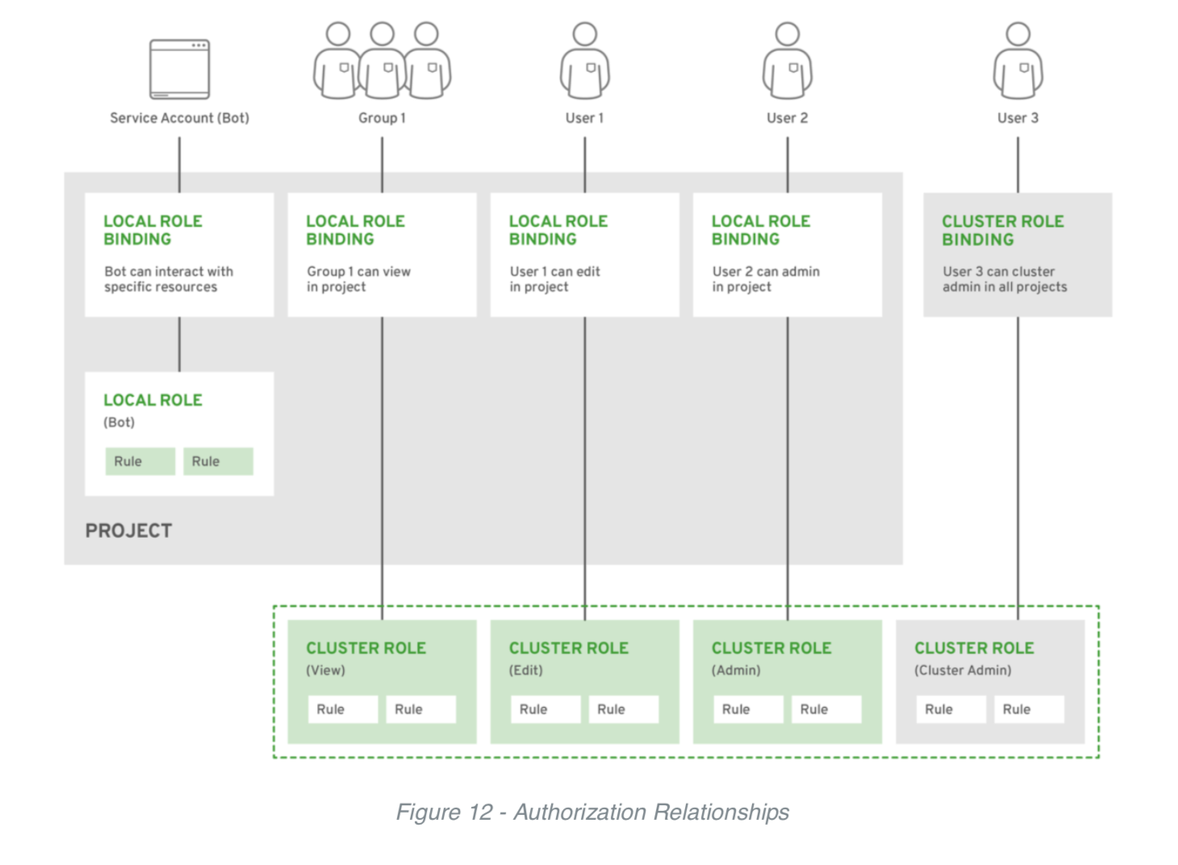
Fine-Grained RBAC
OPENSHIFT SECURITY | Comprehensive features
Project scope & cluster scope available
Matches request attributes (verb,object,etc)
If no roles match, request is denied ( deny by default )
Operator- and user-level roles are defined by default
Custom roles are supported
Notes:
In OpenShift we have a role based authorization component. There is a Project scope and a Cluster scope where either RoleBindings or ClusterRolebindings define the permissions a user will have once logged in. This role component matches attributes on the request like the verb on the objects for example get projects or create pods. It matches those attributes to roles which have been grated to the requesting user. If no roles match the request is denied.By default everything is denied unless the role specifically allows it. Out of the box operator and user level roles are defined and custom roles are also supported.
For more information see: Managing RBAC in OpenShift
Coalfire is a
Payment Card Industry Qualified Security Assessor (QSA)

Slide 75
OpenShift Monitoring
An integrated cluster monitoring and alerting stack

Slide 76



OPENSHIFT MONITORING | Solution Overview
OpenShift Cluster Monitoring
Metrics collection and storage via Prometheus, an open-source monitoring system time series database.
Alerting/notification via Prometheus’ Alertmanager, an open-source tool that handles alerts send by Prometheus.
Metrics visualization via Grafana, the leading metrics visualization technology.

Slide 77
OPENSHIFT MONITORING | Operator & Operand Relationships
Grafana
node-exporter
kube-state-metrics
openshift-state-metrics (4.2)
cluster-monitoring-operator
prometheus-adapter
telemeter-client
Prometheus
Alertmanager
prometheus-operator

Slide 78
OPENSHIFT MONITORING | Prometheus, Grafana and Alertmanager Wiring
Grafana
Prometheus
Alertmanager
Control Plane (API)
kube-state-metrics
node-exporter
node-exporter
Node (kubelet)
Node (kubelet)
Infra/Worker (“hardware”)
Worker (“hardware”)

Slide 79
OpenShift Logging
An integrated solution for exploring and corroborating application logs

Slide 80
Observability via log exploration and corroboration with EFK
OPENSHIFT LOGGING | Solution Overview
Components
Elasticsearch: a search and analytics engine to store logs
Fluentd: gathers logs and sends to Elasticsearch.
Kibana: A web UI for Elasticsearch.
Access control
Cluster administrators can view all logs
Users can only view logs for their projects
Ability to forward logs elsewhere
External elasticsearch, Splunk, etc

Slide 81
OPENSHIFT LOGGING | Operator & Operand Relationships
ElasticSearch Operator
ElasticSearch Cluster
Cluster Logging Operator
Kibana
Curator CronJob
...
Fluentd (per node)
Curator

Slide 82

Log data flow in OpenShift
OPENSHIFT LOGGING | Architecture
Fluentd
Fluentd
TLS
TLS
Node
Fluentd
Elasticsearch
Kibana
Node
Application Logs
Node
Notes:
Elasticsearch clusters store the aggregated log data
Users and platform admins access kibana interfaces to see application aggregated logs or platform aggregated logs
OpenShift can be configured to forward the logs to an external elasticsearch cluster

Slide 83
Log data flow in OpenShift
OPENSHIFT LOGGING | Architecture
stdout stderr
Fluentd
TLS
Elasticsearch
CRI-O
OS DISK
journald
kubelet
Node (OS)
Notes:
Fluentd pulls container logs from cri-o using the log file driver, and from the host using journald

Slide 84
Persistent Storage
Connecting real-world storage to your containers to enable stateful applications

Slide 85
A broad spectrum of static and dynamic storage endpoints
OPENSHIFT CONTAINER PLATFORM | Persistent Storage
NFS
OpenStack Cinder
iSCSI
Azure Disk
AWS EBS
FlexVolume
GlusterFS
Ceph RBD
Fiber Channel
Azure File
GCE Persistent Disk
VMWare vSphere VMDK
NetApp Trident*
Container Storage Interface (CSI)**
Notes:
OpenShift Container Platform leverages the Kubernetes persistent volume (PV) framework to allow administrators to provision persistent storage for a cluster. Using persistent volume claims (PVCs), developers can request PV resources without having specific knowledge of the underlying storage infrastructure.
OpenShift Container Platform supports a growing list of storage plugins for using various storage solutions.
Note that high-availability of storage in the infrastructure is left to the underlying storage provider.
* Shipped and supported by NetApp via TSANet
** Tech Preview
Note for Raw Block GA these support levels:
Supported i.e. GA:
Raw Block with Cloud Providers (AWS, GCP, vSphere, Azure)
Raw Block with Local Volumes
Tech Preview:
Raw Block with iSCSI
Developer Preview:
Raw Block with Cinder
Raw Block with Fibre Channel
Not Supported:
Raw Block with RBD (Ceph)
Raw Block with Gluster

Slide 86
PV Consumption
OPENSHIFT CONTAINER PLATFORM | Persistent Storage
PV
Storage
POD
apiVersion: v1
kind: Pod
metadata:
name: mypod
spec:
containers:
- name: myfrontend
image: nginx
volumeMounts:
- mountPath: "/var/www/html"
name: mypd
volumes:
- name: mypd
persistentVolumeClaim:
claimName: z
CONTAINER
Claim Z
/foo/bar
Kubelet
Node
Notes:
A PersistentVolumeClaim (PVC) is bound to a PersistentVolume (PV), and a PersistentVolume maps to real-world storage
A user defines a workload that instructs OpenShift to attach the PVC’s storage to a mount point inside the container
When the kubelet is told by the master to run the pod, it first tells the host to mount the real-world storage into the OS securely for the container
Then kubelet launches the containers and tells CRI-O to attach the OS mountpoint as a volume inside the container

Slide 87

Static Storage Provisioning
OPENSHIFT CONTAINER PLATFORM | Persistent Storage
Define/Map
NFS PV
iSCSI PV
NFS PV
iSCSI PV
...
NFS PV
iSCSI PV
2Gi NFS
Admin
POD
PersistentVolumes
CONTAINER
Bind
Mount
Claim Z
... VolumeMount: Z
2Gi RWX
Pod Definition
User
Notes:
Administrators define a pool of Persistent Volumes (PV) which are backed by network storage solutions like NFS, iSCSO, AWS EBS, etc and make them globally available in the OpenShift cluster.
Users within their projects can create a Persistent Volume Claim (PVC) in order to request a PV to be available within their pods. In the pod definition, a developer can refer to the PVC and mount the requested persistent volume inside the pod at an arbitrary path.
If a pod gets restarted, OpenShift mounts the same persistent volume into the pod again so that the pod data is available. PVs outlive the containers that were using them.

Slide 88
Dynamic Storage Provisioning
OPENSHIFT CONTAINER PLATFORM | Persistent Storage
Fast NetApp Flash
2Gi NFS
Mount
Create
NetApp SSD
Block VMware VMDK
POD
Admin
Master
CONTAINER
Good NetApp SSD
Map
PV
StorageClass
Bind
Claim Z
... VolumeMount: Z
User
2Gi RWX Good
Pod Definition
Notes:
Dynamic provisioning allows provisioning persistent volumes on-demand when users request it rather than admins predefining them in advance
StorageClass is a blueprint of how to provision persistent volumes on a network storage. OpenShift provides a set of provisioners that determine what volume plugins should be used for provisioning the volumes. OpenShift also supports third-party plugins that are not part of Kubernetes, such as NetApp Trident
Admins creates a catalog of StorageClasses available in the OpenShift cluster. StorageClass names are arbitrary names to communicate their characteristics
Users can create a Persistent Volume Claim and specify the name of a StorageClass to instruct OpenShift on the type of persistent volume that should be provisioned for the them

Slide 89
Networking

Slide 90
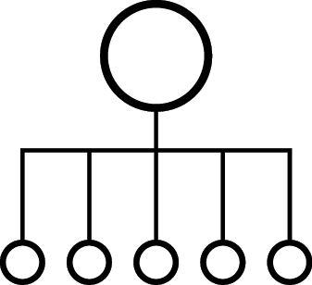


OPENSHIFT NETWORKING
Built-in internal DNS to reach services by name
Split DNS is supported via DNSmasq
Master answers DNS queries for internal services
Other name servers serve the rest of the queries
Software Defined Networking (SDN) for a unified cluster network to enable pod-to-pod communication
OpenShift follows the Kubernetes Container Networking Interface (CNI) plug-in model
Notes:
OpenShift SDN can be configured to use Flannel instead of Open vSwitch. This is useful if running OpenShift Container Platform within a cloud provider platform that also relies on SDN, such as OpenStack, and you want to avoid encapsulating packets twice through both platforms.
OpenShift supports NuageSDN plugin up to and including the CNI plugin. NuageSDN itself is supported by Nuage.

Slide 91

OPENSHIFT NETWORKING
NODE 172.16.1.10
NODE 172.16.1.20
POD 10.1.2.2
POD 10.1.2.4
VxLAN Overlay Network
POD 10.1.4.2
POD 10.1.4.4
IP Network
Notes:
Pods are connected via an overlay network which enables IP-per-Pod networking and direct pod-to-pod communication
The Pod IPs are independent of the physical network the OpenShift Nodes are connected to

Slide 92
OPENSHIFT NETWORK PLUGINS
OPENSHIFT
KUBERNETES CNI
OpenShift SDN
(OVS)
OpenShift
SDN
(OVN*)
Flannel**
Nuage
Tigera
Calico & CNX
Juniper
Contrail
Cisco
Contiv & Contiv-ACI
Big Switch
VMware
NSX-T
kuryr-
k8s
Open Daylight (CNI & Kuryr)
Default in OCP 4.1
Fully Supported
Validated
In-Progress
RH-OSP
Neutron
Plugin
With OSP 14
Notes:
For more details refer to OpenShift Third-Party SDN Statement of Support and FAQ [INTERNAL] https://pnt.redhat.com/pnt/p-7489293/OpenShift_Thi...-Oct-2017.pdf

Slide 93
OPENSHIFT SDN
FLAT NETWORK
All pods can communicate with each other across projects
MULTI-TENANT NETWORK
Project-level network isolation
Multicast support
Egress network policies
NETWORK POLICY (Default)
Granular policy-based isolation
PROJECT A
PROJECT B
PROJECT C
DEFAULT NAMESPACE
NODE
NODE
✓
POD
POD
POD
POD
POD
POD
POD
POD
Multi-Tenant Network
Notes:
When the multi-tenant plugin is enabled, a cluster administrator can define egress firewall policies to limit the external addresses that some or all pods can access from within the cluster, so that for example
A pod can only talk to internal hosts, and cannot initiate connections to the public Internet.
A pod can only talk to the public Internet, and cannot initiate connections to internal hosts (outside the cluster).
A pod cannot reach specified internal subnets/hosts that it should have no reason to contact.

Slide 94
OPENSHIFT SDN - NETWORK POLICY
PROJECT A
PROJECT B
Example Policies
Allow all traffic inside the project
Allow traffic from green to gray
Allow traffic to purple on 8080
8080
✓
POD
POD
5432
POD
POD
apiVersion: extensions/v1beta1
kind: NetworkPolicy
metadata:
name: allow-to-purple-on-8080
spec:
podSelector:
matchLabels:
color: purple
ingress:
- ports:
- protocol: tcp
port: 8080
✓
POD
POD
✓
✓
POD
POD
Notes:
The ovs-networkpolicy plug-in allows project administrators to configure granular isolation policies using NetworkPolicy objects.
A network policy is a specification of how groups of pods (using labels) are allowed to communicate with each other and other network endpoints
By default, all projects are able to access pods in all other projects. The project to be isolated must first be configured to opt in to isolation by setting the proper annotation on its Namespace object, and then creating NetworkPolicy objects indicating the incoming connections to be allowed.
For further details on network policies, refer to this presentation: https://schd.ws/hosted_files/kccncna17/46/ahmetb%20KubeCon%202017%20NA%20%E2%80%93%20Network%20Policies.pdf

Slide 95
services provide internal load-balancing and service discovery across pods
BACKEND SERVICE
172.30.170.110
role: backend
POD
POD
POD
POD
CONTAINER
CONTAINER
CONTAINER
CONTAINER
10.140.4.44
10.110.1.11
10.120.2.22
10.130.3.33
role: frontend
role: backend
role: backend
role: backend
Notes:
A service is a grouping of pods that are running on the cluster based on a set of labels (selector). Services provide important features that are standardized across the cluster: internal load-balancing, service discovery between applications, and features to support zero-downtime application deployments.
Backing pods can be added to or removed from a service arbitrarily while the service remains consistently available, enabling anything that depends on the service to refer to it at a consistent address.
Services are assigned an IP address and port pair that, when accessed, proxy to an appropriate backing pod.

Slide 96
apps can talk to each other via services
Invoke Backend API
BACKEND SERVICE
172.30.170.110
role: backend
POD
POD
POD
POD
CONTAINER
CONTAINER
CONTAINER
CONTAINER
10.140.4.44
10.110.1.11
10.120.2.22
10.130.3.33
role: frontend
role: backend
role: backend
role: backend

Slide 97
BUILT-IN SERVICE DISCOVERY INTERNAL LOAD-BALANCING
SERVICE
Name: payroll-frontend
IP: 172.10.1.23
Port: 8080
app=payroll
role=frontend
POD
POD
POD
app=payroll
app=payroll
role=frontend
role=frontend
app=payroll
version=1.0
version=1.0
role=backend
Notes:
A service is a grouping of pods that are running on the cluster based on a set of labels (selector). Services provide important features that are standardized across the cluster: internal load-balancing, service discovery between applications, and features to support zero-downtime application deployments.
Backing pods can be added to or removed from a service arbitrarily while the service remains consistently available, enabling anything that depends on the service to refer to it at a consistent address.
Services are assigned an IP address and port pair that, when accessed, proxy to an appropriate backing pod.
On the slide, the service is configured to discover pods and load-balance traffic between pods that have both app=payroll and role=frontend labels set
OpenShift has a built-in DNS so that the services can be reached by the service DNS as well as the service IP/port. In this example, service can be reach by the DNS name “payroll-frontend” without specifying the IP. This simplifies service discovery for applications since the service name tends to be constant across environments (dev, test, prod, etc) during the service lifecycle.
In order to reach a service by name across namespaces, one can use <service>.<pod_namespace>.svc.cluster.local

Slide 98
BUILT-IN SERVICE DISCOVERY INTERNAL LOAD-BALANCING
SERVICE
Name: payroll-frontend
IP: 172.10.1.23
Port: 8080
app=payroll
role=frontend
POD
POD
POD
POD
app=payroll
app=payroll
app=payroll
role=frontend
role=frontend
role=frontend
app=payroll
version=2.0
version=1.0
version=1.0
role=backend
Notes:
When a new pod is deployed on the cluster with the same labels as the service selector, it is automatically added to the list of endpoints load-balanced by the service. If one of the pod gets removed, the service immediately removes it from the list of endpoints and does not send traffic to it anymore.
Service selector allows load-balancing between multiple versions of the application pods (version=1.0 and version=2.0) in order to achieve A/B testing and other deployment patterns out-of-the-box
On the slide, the service is configured to discover pods and load-balance traffic between pods that have both app=payroll and role=frontend labels set. Since both v1 and v2 of the frontend pods are deployed and have those labels set, ⅓ of the traffic would be to sent to the frontend v2 to achieve canary release or A/B testing for example.

Slide 99

ROUTE SPLIT TRAFFIC
Split Traffic Between Multiple Services For A/B Testing, Blue/Green and Canary Deployments
ROUTE
90% traffic
10% traffic
SERVICE A
SERVICE B
App A
App A
App B
App B

Slide 100
EXTERNAL TRAFFIC TO A SERVICE ON A RANDOM PORT WITH NODEPORT
NodePort binds a service to a unique port on all the nodes
Traffic received on any node redirects to a node with the running service
Ports in 30K-60K range which usually differs from the service
Firewall rules must allow traffic to all nodes on the specific port
CLIENT
connect 192.10.0.10:31421
192.10.0.11:31421
192.10.0.12:31421
SERVICE
INT IP: 172.1.0.20:90
POD 10.1.0.1:90
POD
10.1.0.2:90
POD
10.1.0.3:90
NODE 192.10.0.10
NODE 192.10.0.11
NODE 192.10.0.12
Notes:
NodePort allow exposing non-standard ports for a service on all nodes in the cluster
If the node receiving the traffic doesn't have the target service running, the traffic is redirected to a node which has the pod running
While it is easier to configure than external IPs and Ingress (prev slide), it is a wasteful use of scarce port resources and it requires more privileges.

Slide 101
EXTERNAL TRAFFIC TO A SERVICE ON ANY PORT WITH INGRESS
Access a service with an external IP on any TCP/UDP port, such as
Databases
Message Brokers
Automatic IP allocation from a predefined pool using Ingress IP Self-Service
IP failover pods provide high availability for the IP pool
CLIENT
connect 200.1.0.10:90
SERVICE
EXT IP: 200.1.0.10:90
INT IP: 172.1.0.20:90
POD 10.1.0.1:90
POD
10.1.0.2:90
POD
10.1.0.3:90
NODE 192.10.0.10
NODE 192.10.0.11
NODE 192.10.0.12
Notes:
External IP allows assigning an external IP to a service so that client outside of the OpenShift cluster can connect to services inside the Openshift cluster (e.g. database, JMS broker) on that port. This is particularly useful for services that are running on ports other than 80/433, otherwise router is a more suitable alternative. It is also useful when the client needs to know a specific IP for the service in order to open firewalls or while-list it in their own system.
Each external IP address is guaranteed to be assigned to a maximum of one service. This ensures that each service can simply expose its chosen ports regardless of the ports exposed by other services.
The external IP address itself is not managed by the underlying Kubernetes infrastructure and must be maintained and provided by a cluster administrator. Managing external IPs is not convenient since application users cannot create external IP addresses themselves, and must work with cluster administrators to allocate an address for their usage. There is also no protections in place to restrict the usage of a particular external address configured within the cluster.
Ingress IP self-service is a functionality within OpenShift to streamline the allocation of External IP’s for accessing to services in the cluster. Cluster administrators can designate a range of addresses using a CIDR notation which allows an application user to make a request against the cluster for an external IP address. When a service is configured with the type LoadBalancer, an External IP address will be automatically assigned from the designated range.
Ingress is supported for non-cloud clusters. For cloud (GCE, AWS, and OpenStack) clusters, cloud provider’s load balancer service can be used to automatically deploy a load balancer to target the service’s endpoints.
The IP failover pods are responsible for providing the external IP range (Virtual IPs) and would run on one or more of the nodes (more than one for high availability) in the cluster or they can just run on the HAProxy (router) nodes.
The OpenShift cluster administrator must ensure that the external IP address pool terminates at one or more nodes in the cluster.

Slide 102
CONTROL OUTGOING TRAFFIC
SOURCE IP WITH EGRESS ROUTER
POD
NODE IP1
EXTERNAL SERVICE
Whitelist: IP1
POD
EGRESS SERVICE INTERNAL-IP:8080
EGRESS
ROUTER POD IP1
POD
Notes:
Egress router runs a service that redirects (proxies) traffic to a specified remote server, using a private source IP address that is not used for anything else. The service allows pods to talk to servers that are setup to only allow access from whitelisted IP addresses. When deploying an egress router, an IP address from the physical network that the node itself is on is reserved by the cluster administrator to be used by the egress router.
Application pods access the external service using the egress service on the service internal IP address or service name. The egress service redirects the traffic to the egress routers which in turn send the traffic to the external service with the egress IP (reserved on the node it’s running on) as the source IP. The external service accepts the traffic since the source IP (egress router IPs) is whitelisted.

Slide 103

ROUTING AND EXTERNAL LOAD-BALANCING
Pluggable routing architecture
HAProxy Router
F5 Router
Multiple-routers with traffic sharding
Router supported protocols
HTTP/HTTPS
WebSockets
TLS with SNI
Non-standard ports via cloud load-balancers, external IP, and NodePort

Slide 104
routes add services to the external load-balancer and provide readable urls for the app
ROUTE app-prod.mycompany.com
> curl http://app-prod.mycompany.com
BACKEND SERVICE
POD
POD
POD
CONTAINER
CONTAINER
CONTAINER
Notes:
A router uses the service selector to find the service and the endpoints backing the service. When both router and service provide load balancing, OpenShift Container Platform uses the router load balancing. A router detects relevant changes in the IP addresses of its services and adapts its configuration accordingly
A built-in router comes with OpenShift however it can be replaced by external load-balancers like F5

Slide 105


ROUTE EXPOSES SERVICES EXTERNALLY
EXTERNAL TRAFFIC
ROUTER
SERVICE
INTERNAL TRAFFIC
POD
POD
POD
Notes:
A route exposes a service at a host name, like www.example.com, so that external clients can reach it by name.
DNS resolution for a host name is handled separately from routing. Admin may have configured a DNS wildcard entry that will resolve to the node that is running the OpenShift Container Platform router
Pods running on OpenShift, don’t need to go through the routing layer and can interact with each other directly through the services.
After the router discovers the Pod endpoints via the service, it sends the Pod traffic directly to those endpoints and bypasses the service layer

Slide 106
OPENSHIFT SDN - OVS PACKET FLOW
Container to Container on the Same Host
NODE
POD 1
veth0 10.1.15.2/24
br0 10.1.15.1/24
vxlan0
eth0
POD 2
192.168.0.100
veth1 10.1.15.3/24

Slide 107
OPENSHIFT SDN - OVS PACKET FLOW
Container to Container on the Different Hosts
NODE 1
POD 1
veth0 10.1.15.2/24
br0 10.1.15.1/24
vxlan0
eth0
192.168.0.100
NODE 2
POD 2
veth0 10.1.20.2/24
br0 10.1.20.1/24
vxlan0
eth0
192.168.0.200

Slide 108
OPENSHIFT SDN - OVS PACKET FLOW
Container Connects to External Host
Container to Container on Different Hosts
NODE 1
External Host
POD 1
veth0 10.1.15.2/24
br0 10.1.15.1/24
tun0
eth0
192.168.0.100

Slide 109
Build and Deploy Container Images
Tools and automation that makes developers productive quickly

Slide 110



BUILD AND DEPLOY | Three Ways to Serve Developers
DEPLOY YOUR
SOURCE CODE
DEPLOY YOUR
APP BINARY
DEPLOY YOUR
CONTAINER IMAGE

Slide 111




BUILD AND DEPLOY | Source-to-Image (S2I) for building and deploying from code
Code (Git)
Developer
Repository
CODE APPLICATION
Image Registry
Builder
Image
S2I
BUILD IMAGE
Application Image
DEPLOY

